Slide 1


Deployment Strategies in a Kubernetes - Based Microservices Architecture
Department of Information Technology

Slide 2
A Comparative Performance Analysis of Canary vs. Blue - Green Deployment Strategies
Group ID: 2
Group Members:
16010422230 - KRISHI JAIN
16010422231 - KAUSTUBH NAIR
16010422233 - PRACHI GANDHI
16010422234 - CHANDANA RAMESH GALGALI

Slide 3
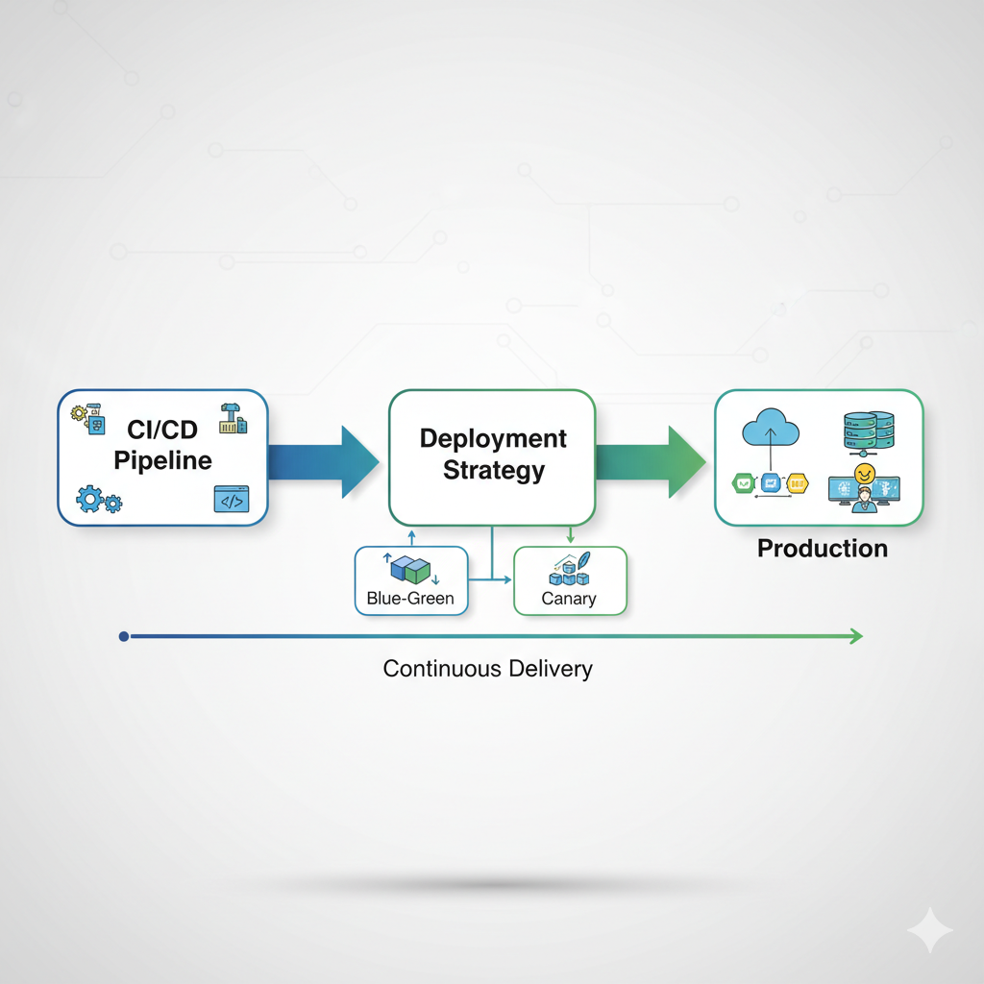
The Challenge of Zero - Downtime Continuous Delivery (CD)
The DevOps Mandate: Organizations strive for rapid and reliable software releases by enhancing CI/CD pipelines.
Core Problem: How to deploy new application versions while minimizing downtime and mitigating risks?
Blue-Green Deployment (BG): Involves maintaining two identical production environments (live and idle).
Canary Deployment: Gradually rolls out new versions to a subset of users, enabling early issue detection.

Slide 4
Strategy 1: Blue-Green Deployment (The "Instant Switch")
The live system (Blue) and the new version (Green) run in parallel; traffic is switched between them.
Key Advantages (Speed & Recovery)
Key Disadvantages (Cost & Risk)
Enables seamless rollbacks.
Provides minimal downtime during the switch.
High Infrastructure Overhead: Requires duplication of the production environment.
Infrastructure overhead was reported at 65%.

Slide 5
Strategy 2: Canary Deployment (The "Gradual Rollout")
New release is exposed to a small subset of users before a full rollout. This allows for real-time monitoring and validation.
Key Advantages (Risk Mitigation)
Key Disadvantages (Complexity)
Exhibited a lower failure rate (3%) than BG (5%).
Perceived to be more effective (85%) in reducing risk exposure.
Showed slightly better system stability (99.98% uptime).
Longer Time-to-Deploy (30 mins) compared to BG (15 mins).
Requires sophisticated traffic routing complexities and monitoring overhead.

Slide 6
Quantitative Analysis: Comparing Core Performance Metrics
Metric | Blue-Green Deployment | Canary Deployment
Average Deployment Time (TTD) | 15 mins | 30 mins
Failure Rate | 5% | 3%
User Impact (Errors/1000 users) | 12 | 5
Infrastructure Overhead | 65% | 50%

Slide 7
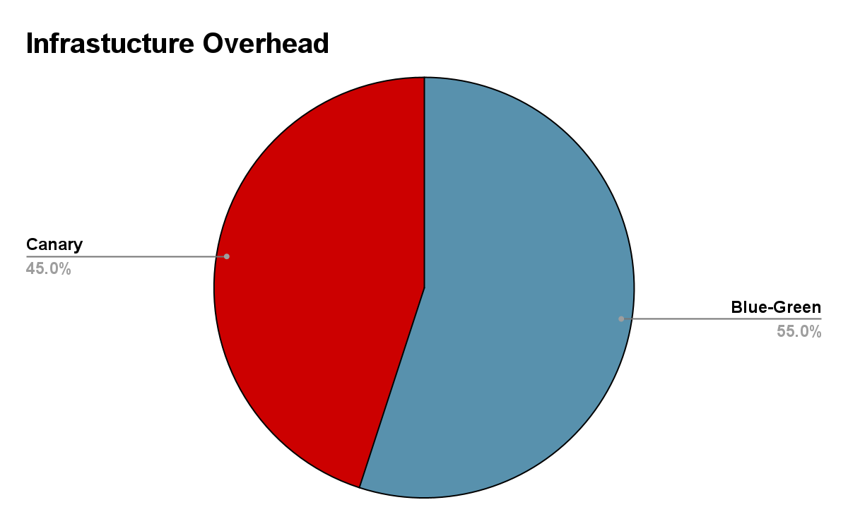
Statistical Analysis: The Trade-Offs
(Risk vs. Cost)
Failure Rate (Canary Wins): T-Test confirmed Canary Deployments significantly reduce failure rates (p<0.05). Fewer user disruptions (5 vs. 12 error reports per 1000 users).
Rollback Success (Comparable): Chi-Square Test showed no significant difference in rollback success rates (p>0.05). Both provide robust failure recovery.
Infrastructure Cost (BG Loses): ANOVA confirmed Blue-Green requires significantly higher infrastructure investment (p<0.01).

Slide 8





Industry Adoption and the Rise of the Hybrid Model
Case Studies: Strategy Alignment
Netflix (Canary): Prioritizes low risk/user impact; uses AI-driven anomaly detection.
Amazon (Blue-Green): Prioritizes instant rollback; critical for transactional security (e-commerce).
The Hybrid Model (Google):
Combines Canary for new features and Blue-Green for critical system updates.
Goal: Optimize both speed and stability.
Start
Is Risk Tolerance High?
No
Yes
No
Yes
Is Infrastructure Budget Low?
Deploy

Slide 9
Conclusion: The Strategic Deployment Choice
Summary of Trade-Offs:
Blue-Green: Best for Speed (15 mins TTD) and Instant Rollback. High resource cost.
Canary: Best for Risk Mitigation (3% failure) and Stability. Longer rollout time.
Key Recommendations:
Strategic Alignment: Match strategy to the application's risk profile (e.g., Canary for financial, BG for SaaS).
Cost: Small-to-medium enterprises (SMEs) should favor Canary to avoid high BG infrastructure costs.
Future: Adopt a Hybrid Model and invest in AI-driven monitoring for optimal outcomes.

Slide 10
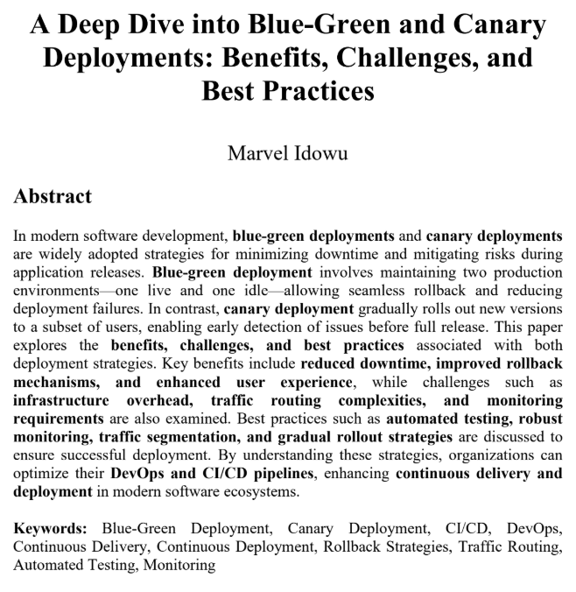
References
M. Idowu and B. Barnty, "A Deep Dive into Blue-Green and Canary Deployments: Benefits, Challenges, and Best Practices," ResearchGate, Article, March 2025. [Online].
Available: https://www.researchgate.net/publication/390108683

